Slide 1
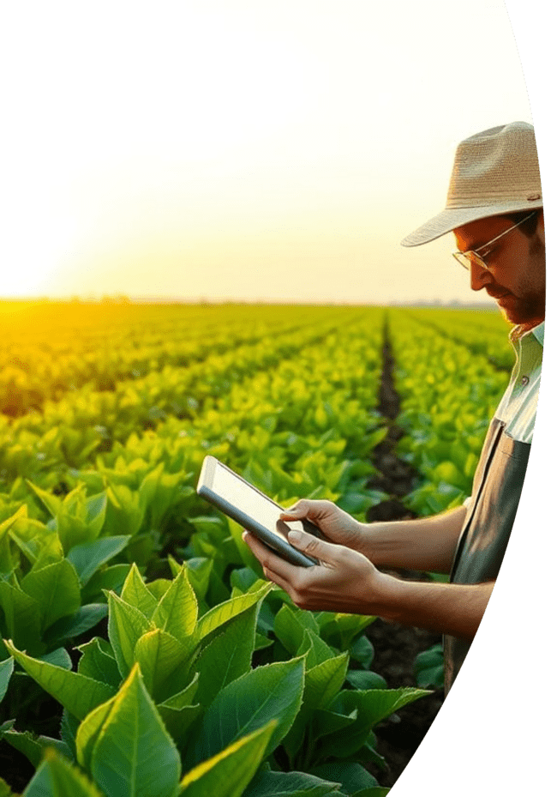
Farmer Agent AI
Smart Agricultural Assistant for Small and Urban Farmers

Slide 2
The Challenge for Small Farmers
Lack of Expert Advice
Crop Health Issues
Market Access & Weather Volatility
Limited access to agronomists and up-to-date farming knowledge.
Difficulty in identifying and treating diseases, leading to significant losses.
Struggles with unpredictable weather and accessing fair market prices.

Slide 3
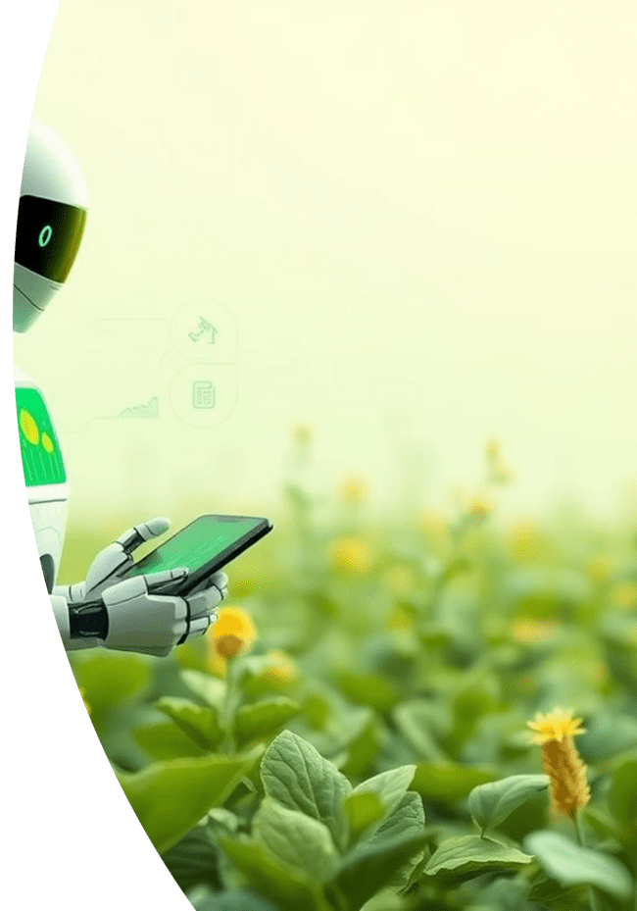



Our Solution: Farmer Agent AI
AI-Powered Advice
Real-time, data-driven agricultural recommendations.
Multilingual Support
Accessible in local languages via voice and text.
Sustainable Practices
Guidance for improved crop yield and reduced losses.

Slide 4
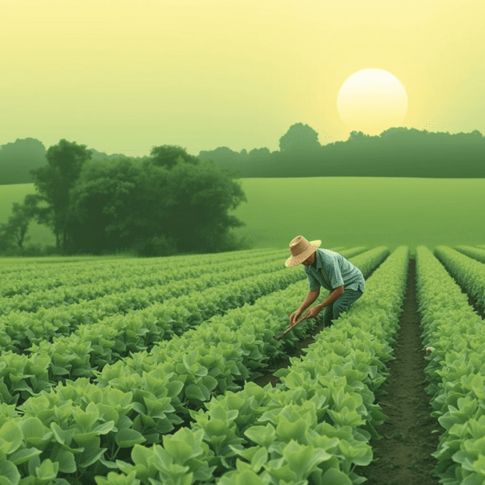
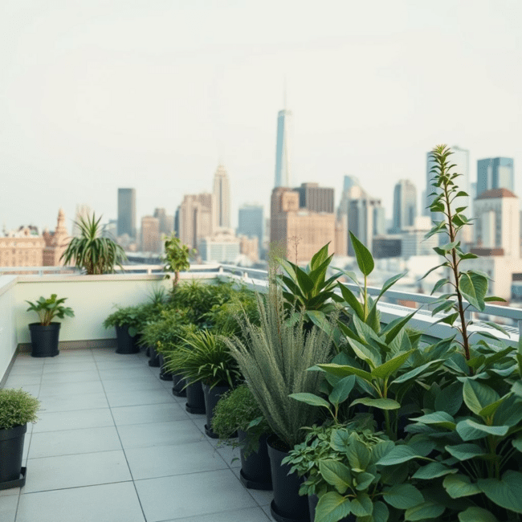
Empowering Our Target Users
Small-Scale Rural Farmers
Urban & Peri-Urban Growers
Providing essential tools and knowledge to enhance traditional farming methods.
Supporting efficient and productive farming in limited spaces within or near cities.
Our focus includes digitally underserved and low-literate farmers, ensuring inclusive access to technology.

Slide 5




Core Technologies Driving Farmer Agent AI
AI & Machine Learning
Multilingual NLP
For predictive analysis and personalized recommendations.
Seamless voice and text interaction in diverse languages.
Offline Capability
Real-time Integration
Ensuring functionality in areas with limited internet access.
Connecting to weather, soil, and market APIs for live data.

Slide 6
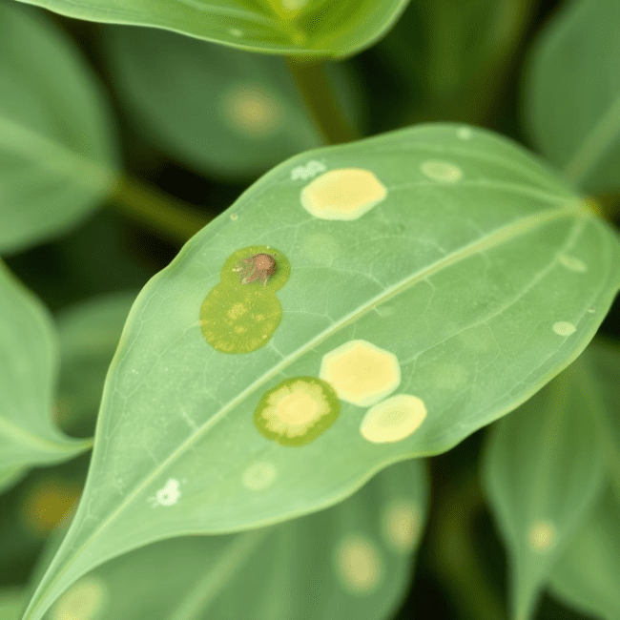
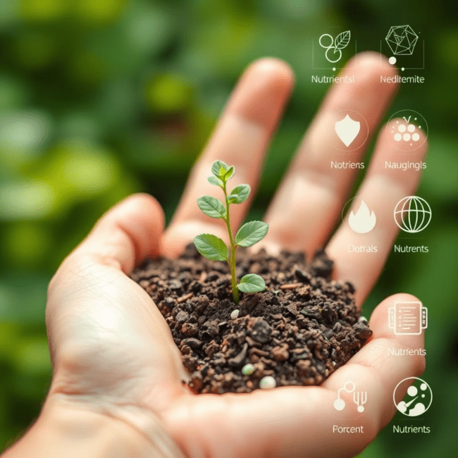
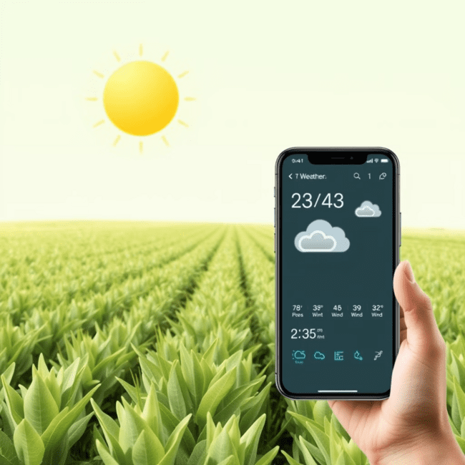
Key Features: Predictive & Advisory
Plant Disease Detection
Crop & Soil Advisory
Weather Forecasting & Alerts
Upload images or describe symptoms; AI identifies diseases and suggests treatments with local language support.
Receive crop recommendations based on soil tests, fertilizer suggestions, and smart seasonal planning.
Hyperlocal real-time weather updates with rain, drought, and storm alerts, adjusting advice accordingly.

Slide 7



Transformative Impact & Benefits
Empowering Farmers
Economic Upliftment
Digital Inclusion
Enabling informed, data-driven decisions for better farming outcomes.
Preventing crop losses, reducing costs, and significantly improving farmer income.
Bridging the technology gap in agriculture for underserved communities.

Slide 8
Future Scope & Vision
Global Expansion
1
Expanding to new crop and climate zones worldwide.
IoT Sensor Integration
2
Real-time soil data and environmental monitoring for precision farming.
Drone & Satellite Imagery
3
Advanced crop monitoring and health assessment from above.
Thank you for your time and interest in Farmer Agent AI. We welcome your questions!

